Slide 1
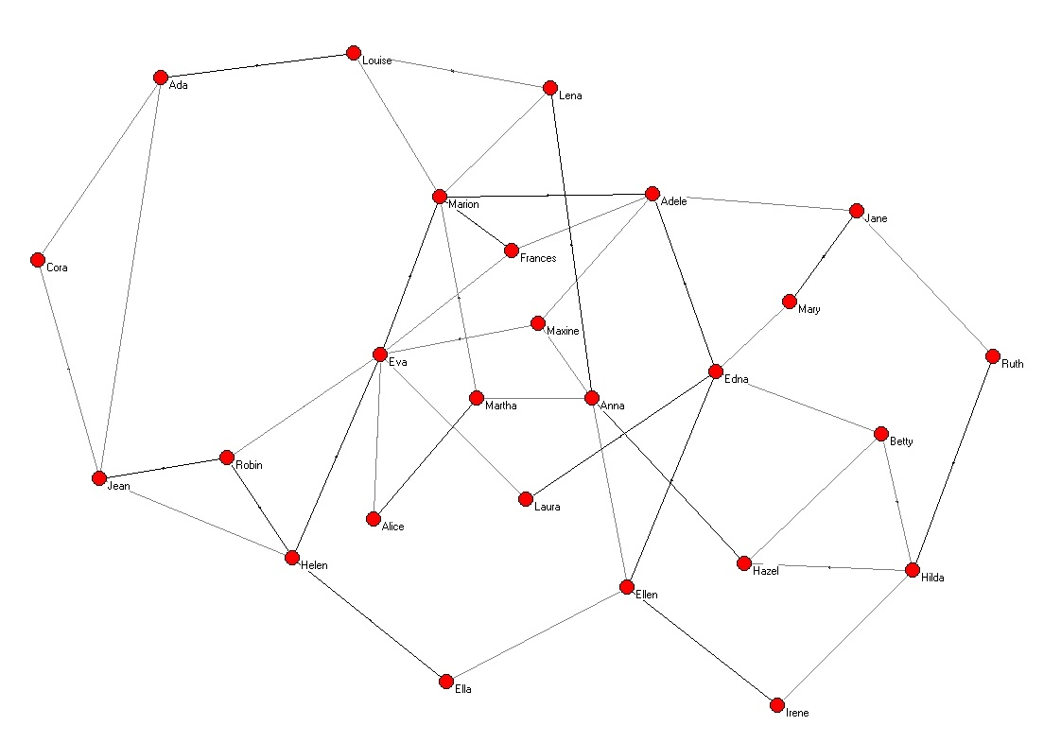
Fundamental Concepts
Graph: A set of vertices and a set of lines between pairs of vertices.
Key Elements of a Graph
Vertices, Nodes, or Dots
Lines
Layout
A network is a graph where the vertices are assigned attributes such as names (e.g., Laura or Intel), categories ( e.g., messenger ribonucleic acid or sensory neurons), or continuous features such as size or weight).

Slide 2
Fundamental Concepts
Networks can differ with respect to their nodes, edges, and layout
Nodes
Unimodal | Multimodal
The Yankees
Hilda
Betty
Hazel
Mantle
DiMaggio

Slide 3
Fundamental Concepts
Edges: Direction and Weight (e.g., frequency or distance) provide more information
Undirected (Edges) | Directed (Arcs and Loops)
Dichotomous
1
1
Weighted
0.25
0.5
Loops refer to arcs directed to oneself. Dichotomous networks are also called binary networks.
Multiplex networks refer to networks with more than one tie type (e.g., friends you ask advice from on important matters vs. friends you work with on projects).
Although some people may be connected through both types of ties; the ties are, nevertheless, different because they represent different kinds of relations.

Slide 4
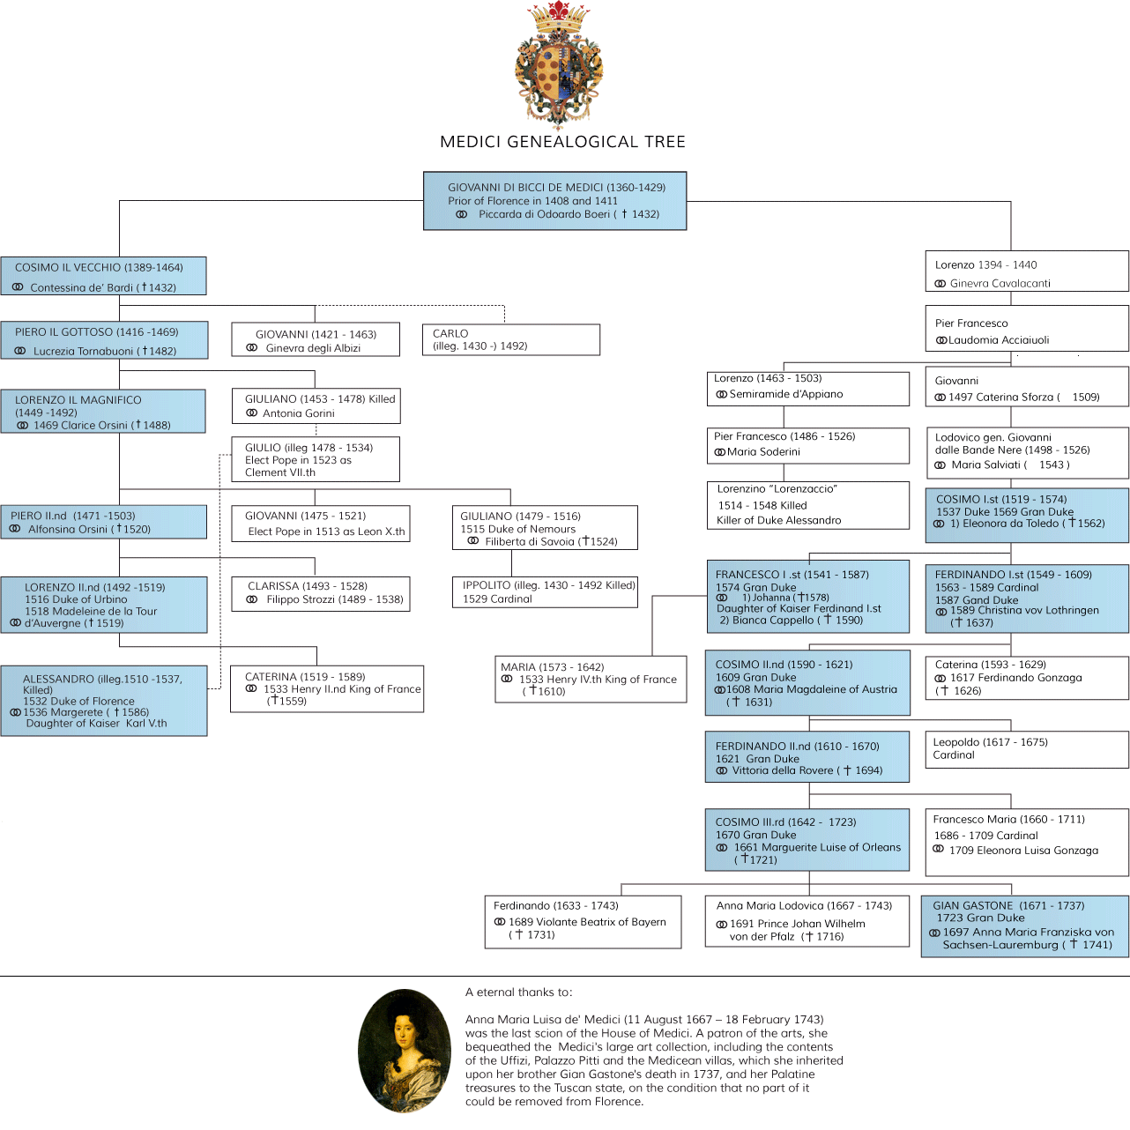
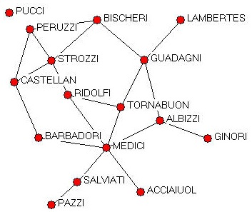
Fundamental Concepts
Layouts
Hierarchical | Spring or Energy
Padgett’s Florentine Marriage Alliances
Medici Genealogical Tree: http://www.museumsinflorence.com/musei/genealogic_tree.htm

Slide 5
Fundamental Concepts
Data Structures
Adjacency Matrix
Edgelist
4
4
1
2
3
1
2
3
1 2 3 4
1 0 0 0 1
2 0 0 0 1
3 0 0 0 1
4 1 1 1 0
Sender Target Weight
1 4 1
2 4 1
3 4 1

Slide 6
Telling a Story with Networks
Two General Sometimes Overlapping Approaches
Networks as Variables
Networks as Structures
Both approaches leverage connectionist vs. positional features of the network.

Slide 7
Telling a Story with Networks: Networks as Variables
This approach involves performing a network analysis to identify an individual’s network position and other characteristics. These characteristics are then used as predictors in subsequent statistical analysis.
Networks as Variable Approaches Are Applicable for Research Questions such as:
Are kids with smoking peers more likely to smoke themselves?
Do positions in a social network influence the mental health of the people
occupying them?
Do central actors control resources?

Slide 8
Telling a Story with Networks: Networks as Structures
This approach involves performing a network analysis to identify system-level properties that influence how the network will change and function over time.
Networks as Structures Approaches Are Applicable for Research Questions such as:
What generates hierarchy in social relations?
What network patterns spread disease more quickly?
How do roles such as being the “go-to-person” or “broker” in the network
evolve out of consistent relational activity?

Slide 9
Telling a Story with Networks: Network Features
Networks as Variables and Networks as Structures Approaches Are Complimentary Approaches that often Overlap.
For example, emerging roles identified by looking at the structure of the network can be treated as individual-level correlates in a regression analysis.
Both approaches rely on understanding both the connectionist features of the network (how it’s wired), and positional features (the nodes’ positions in the network as a consequence of the network’s wiring).

Slide 10
Telling a Story with Networks: Connectionist Features of a Network
Connectionist features of a network refer to features emerging from the configuration of its ties. We generally think of these features as system-level features.
Common features of interest include:
Density: The proportion of actually connected ties over all possible connections. Dense networks are highly connected networks where information, diseases, or resources can quickly move across the network.
Most social networks; however, are not uniformly connected because the opportunity to make a tie can vary highly, and ties generally require time and resources to maintain.
So, we often look at four other features when we first want to tell a network story: average path length, transitivity, clustering, and the network’s degree distribution.
Visually, if we are interested in changes over time, we will generally plot these measures using scatter plots or line graphs that consist of a point estimate and a confidence interval.

Slide 11
Telling a Story with Networks: Connectionist Features of a Network
Average Path Length refers to the average number of steps along the shortest paths for all possible pairs of network nodes. Average path length measures how efficiently information moves through the network.
How Does Information Get Around: Walks, Trails, Circuits, Paths, and Cycles Oh My
Concept | Vertex Properties | Edge Properties | Closed or Open
Walk | Vertices may repeat | Edges may repeat | Closed or Open
Trail | Vertices may repeat | Edges cannot repeat | Open
Circuit | Vertices may repeat | Edges cannot repeat | Closed
Path | Vertices cannot repeat | Edges cannot repeat | Open
Cycle | Vertices cannot repeat | Edges cannot repeat | Closed

Slide 12
Telling a Story with Networks: Connectionist Features of a Network
Transitivity refers to the extent to which nodes making up a dyad that are also connected to a third node will both be connected to that third node.
In social networks, high transitivity can indicate social closure mechanisms that might be important such as mutualism, shared costs, a common enemy or threat, or social sanctioning.
Open Triad
Closed Triad

Slide 13
Telling a Story with Networks: Connectionist Features of a Network
A clustering coefficient measure the degree to which nodes in a graph tend to cluster together.
In social networks, we frequently observe distinct clusters of nodes who share a common feature such as proximity, shared interests, or other situational features.
When assessing the level of clustering over the entire graph, we calculate the proportion of closed triads over the total number of triads both closed and open.
From a connectionist perspective, clusters, especially isolated clusters, act a bottlenecks. For example, an infection within a cluster can be devastating to the members of the cluster, but the risk to the entire network is likely to be fairly low. The disease may, in fact, die off with that cluster.
Visually, we can perform clustering analyses to highlight the clusters present in the network, and statistically test whether they have a moderating influence on outcomes we care about.

Slide 14
Telling a Story with Networks: Connectionist Features of a Network
Degree Distribution:
Degree refers to number of connections a node has with other nodes
A degree distribution is the probability distribution describing the
likelihood of a given degree.
Descriptively, we want to know the distribution of connections we actually observe. For example, how many friends on average do teenagers in the school we are studying have?
To infer probability, we have to make further assumptions about the tie generation process.
Thinking through these assumptions can be very helpful for thinking about the influence of the network.

Slide 15
Telling a Story with Networks: Positional Features
Positional Features: Positional features are node-level properties associated with occupying a particular place or performing a particular role in a network.
Positional features are frequently measured using power and centrality measures. There are numerous measures, many tailored to specific research questions such as optimizing web searches or identifying important positions in influence networks.
We introduce some commonly-used measures in social network analysis, but for a more comprehensive overview see Wasserman and Faust (1994) and Borgatti and Martin (2006).
Common positional features include: Degree, Closeness Centrality, Betweeness Centrality, and Eigenvector Centrality.
Wasserman, Stanley, and Katherine Faust. 1994. Social Network Analysis: Methods and Applications (Vol. 8). Cambridge University Press.
Borgatti, Stephen P.; Everett, Martin G. 2006. "A Graph-Theoretic Perspective on Centrality". Social Networks. Elsevier. 28: 466–484.

Slide 16
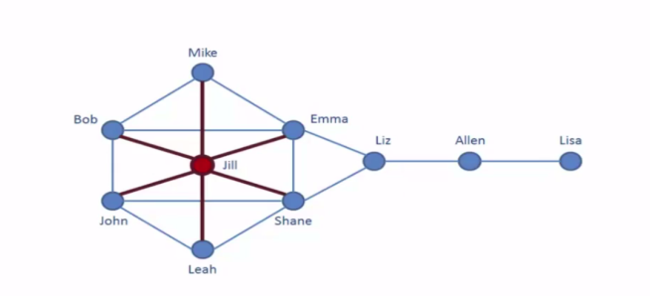
Telling a Story with Networks: Positional Features
Degree Centrality: A node’s degree centrality refers to the number of ties it has.
Figures From: https://friendsarena.wordpress.com/category/uncategorized/

Slide 17
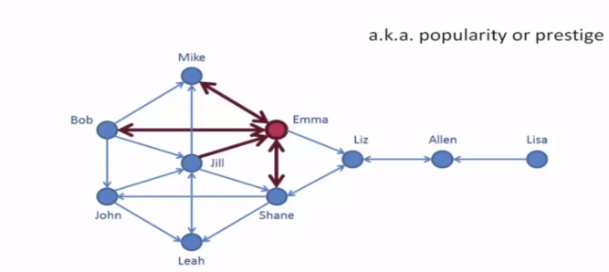
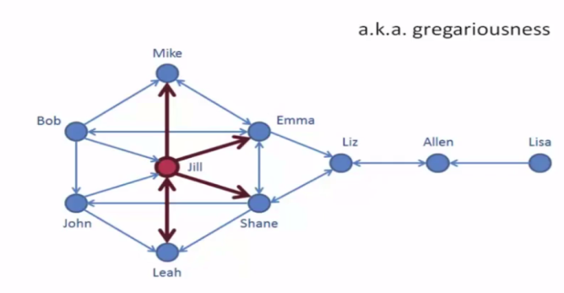
Telling a Story with Networks: Positional Features
In-Degree Centrality: A node’s in-degree centrality refers to the number of ties it receives.
Out-Degree Centrality: A node’s out-degree centrality refers to the number of ties it sends.
Note: To calculate these measures, you need to have a directed network.
Figures From: https://friendsarena.wordpress.com/category/uncategorized/

Slide 18
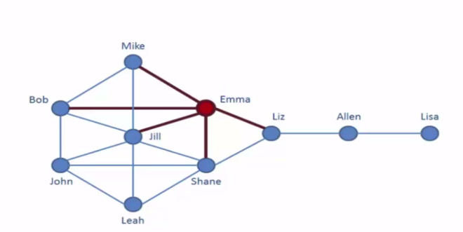
Telling a Story with Networks: Positional Features
Closeness Centrality: The closeness centrality of a node is the average length of the shortest path between the node and all other nodes. The most central the node the closer it is to all the other nodes.
Note: Shane’s closeness centrality is equivalent to Emma’s.
Closeness centrality like degree centrality can be calculated in terms of closest to (incoming
ties) and from (outgoing ties) in directed networks.
Figures From: https://friendsarena.wordpress.com/category/uncategorized/

Slide 19
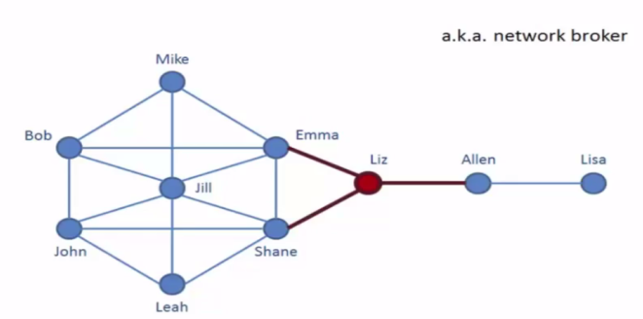
Telling a Story with Networks: Positional Features
Betweeness Centrality: A node’s betweeness centrality is the number of times a node acts as a bridge along the shortest path between two other nodes.
Betweeness Centrality is calculated by:
1. For each pair of nodes, compute the shortest paths between them.
2. For each pair of nodes, determine the fraction of shortest paths through
the node in question.
3. Sum this fraction over all pairs of nodes.
Figures From: https://friendsarena.wordpress.com/category/uncategorized/

Slide 20
Telling a Story with Networks: Positional Features
Eigenvector Centrality: A node’s eigenvector centrality measures its influence in terms of how connected the node is to other highly connected nodes.
John
Emma
0.36
0.49
Jill
0.54
Liz
0.19
0.49
0.17
Bob
Shane
0.17
Allen

Slide 21
Telling a Story with Networks: Ties Come from Questions
Ties in network analysis depend on the questions we ask and how we ask them.
When collecting network data, the analyst must first decide what constitutes a meaningful tie between two entities for the analysis in question.
When using network data, ties correspond directly to the questions researchers asked the respondents and how they asked them.
For example when studying the influence of mentors on career advancement, we might ask the following question, Who do you go to for advice on professional matters?
From a network perspective, this question will produce a binary directed tie.
We, however, do not know how important the respondent considers the tie.
To learn that, we would need to ask additional questions such as a, Rate how
important this tie is from 0 (not very important) to 10 (critically important).
Or, we might ask how frequently the respondent seeks advice.

Slide 22
Telling a Story with Networks: Ties Come from Questions
For many research questions, we may need to construct the network based on secondary data sources because no network data at that scale or kind exists.
Constructing networks from secondary data still begins with a question. In this case, we begin with, What constitutes a meaningful tie in this setting?
When using secondary data, we have to infer ties by looking at various kinds of relational data such as co-memberships (two business executives serving on the same board), proximity, or activities such as following a friends on Twitter.
From a network perspective, we often has less information and thus have
simpler ties. We often only know that there is a tie, but not its direction or
weight.
These limitations will preclude certain analyses.

Slide 23
Telling a Story with Networks: How Representative is the Network
Network analyses, like other kinds of analysis, are constrained by how representative the sample is. Meaning, do we capture the full the network or only samples of it from the perspective of our respondents.
Global Network Designs
Ego-Network Designs
Unlike other kinds of analysis, network analysis frequently encounters the boundary problem?
The boundary problem refers to theoretical challenge of defining at what scale are the network effects we are interested in occurring.
The boundary depends on the research question. For example, in studies of adolescent health, we often assume that the school is an appropriate boundary. But, in some contexts, out-of-school ties may be important.
In those instances, we may need to collect additional data either directly or through secondary sources.

